Slide 1
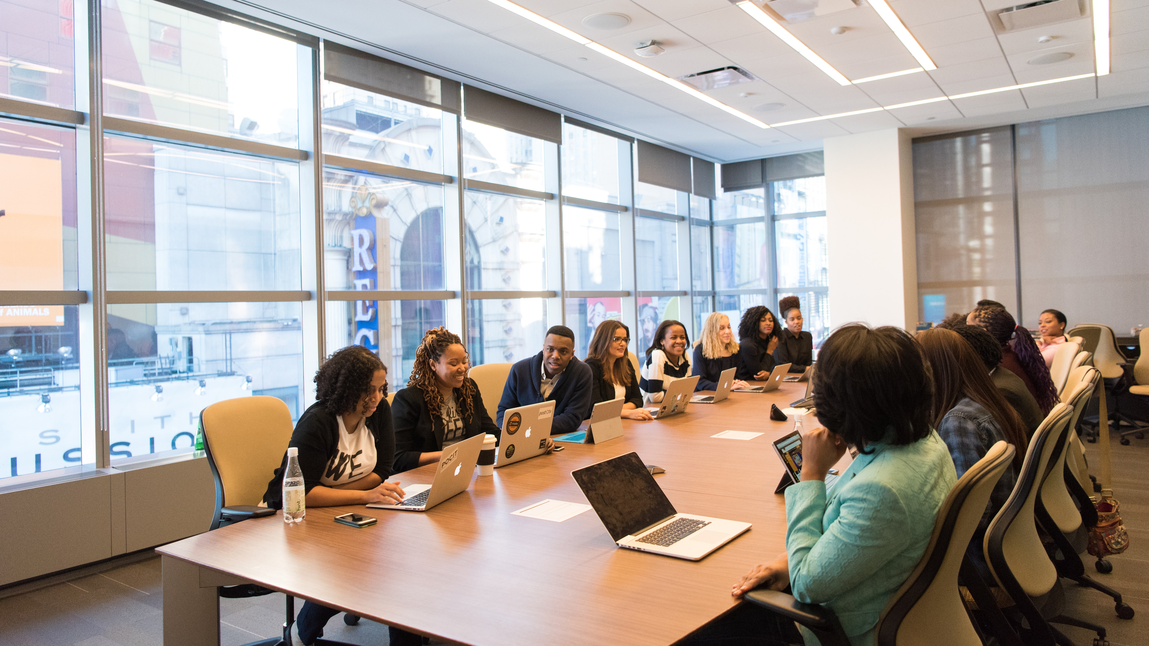
WIFI: visitor, P: BMAHouse1832
UKRI Trustworthy Autonomous Systems Hub
Celebrate
Reflect
Anticipate
AHM 2022
Plan

Slide 2
Welcome
TAS Hub
All Hands Meeting
12th July 2022
Prof. Sarvapali D. (Gopal) Ramchurn
Professor of Artificial Intelligence
University of Southampton
Director, UKRI Trustworthy Autonomous Systems Hub
www.tas.ac.uk
Notes:
Welcome everyone. Mention all those involved.
Housekeeping.

Slide 3
09:30 – 10:00
Welcome by Professor Sarvapali Ramchurn, TAS Director Main Hall
10:00 – 10:15
Overview by UKRI Head of Artificial Intelligence and Robotics , Dr James Dracott Main Hall
10:15 – 10:30
Introduction to the TAS Hub Research Programme , Professor Joel Fischer, TAS Research Director Main Hall
10:30 – 11:00
Research Highlights –
Presentations from Dr Lars Kunze and Dr Mohammad Divband Soorati. Main Hall
11:00 – 11:15
Tea and coffee break Lutyens Suite
11:15 – 12:00
Research Highlights –
Presentations from Dr Maria Galvez Trigo, Professor Radu Calinescu, and Dr Justyna Lisinska. Main Hall
12:00 – 12:30
TAS Research Panel –
Chaired by Professor Joel Fischer, TAS Research Director. Professor Radu Calinescu, Carly Kind, and Dr Kate Devlin. Main Hall
12:30 – 14:30
Lunch and live exhibition of TAS research, demos, policy, and creative work. Lutyens Suite
14:30 – 14:45
TAS Creative Ambassadors – Blast Theory. Main hall
14:45 – 15:45
Translating TAS Research Panel: chaired by Professor Derek McAuley, TAS Deputy Director Professor Dame Wendy Hall, Dr Ben Pritchard (Thales), Miranda Marcus (BBC) and Professor Tom Rodden (DCMS). Main Hall
15:45 – 16:15
Coffee Break
16:15 – 17:15
International Perspectives on TAS Panel: Chaired by Professor Sarvapali Ramchurn, TAS Director.​
Professor Subramanian Ramamoorthy, Professor Milind Tambe, Dr Cara LaPointe and Professor Sharon Strover.
17:15 – 17:30
Closing remarks – Professor Sarvapali Ramchurn
Notes:
Give overview of programme.

Slide 4
Our Vision
To enable the development of socially beneficial autonomous systems that are both trustworthy in principle and trusted in practice by the public, government, and industry.
Notes:
Remind everyone of the vision of the programme. Concerns around what trust means.

Slide 5
Our Definition of Trustworthy
Autonomous Systems
Autonomous systems are trustworthy when their design, engineering, and operation ensures they generate positive outcomes and mitigates potentially harmful outcomes.
Whether they are trusted depends on a number of factors including but not limited to:
Their robustness in dynamic and uncertain environments.
The assurance of their design and operation through verification and validation processes.
The confidence they inspire as they evolve their functionality.
Their explainability, accountability, and understandability to a diverse set of users.
Their defences against attacks on the systems, users, and the environment they are deployed in.
Their governance and the regulation of their design and operation.
The consideration of human values and ethics in their development and use
Notes:
Constructed by the hub and the nodes. Highlight the socio-technical issues.

Slide 6
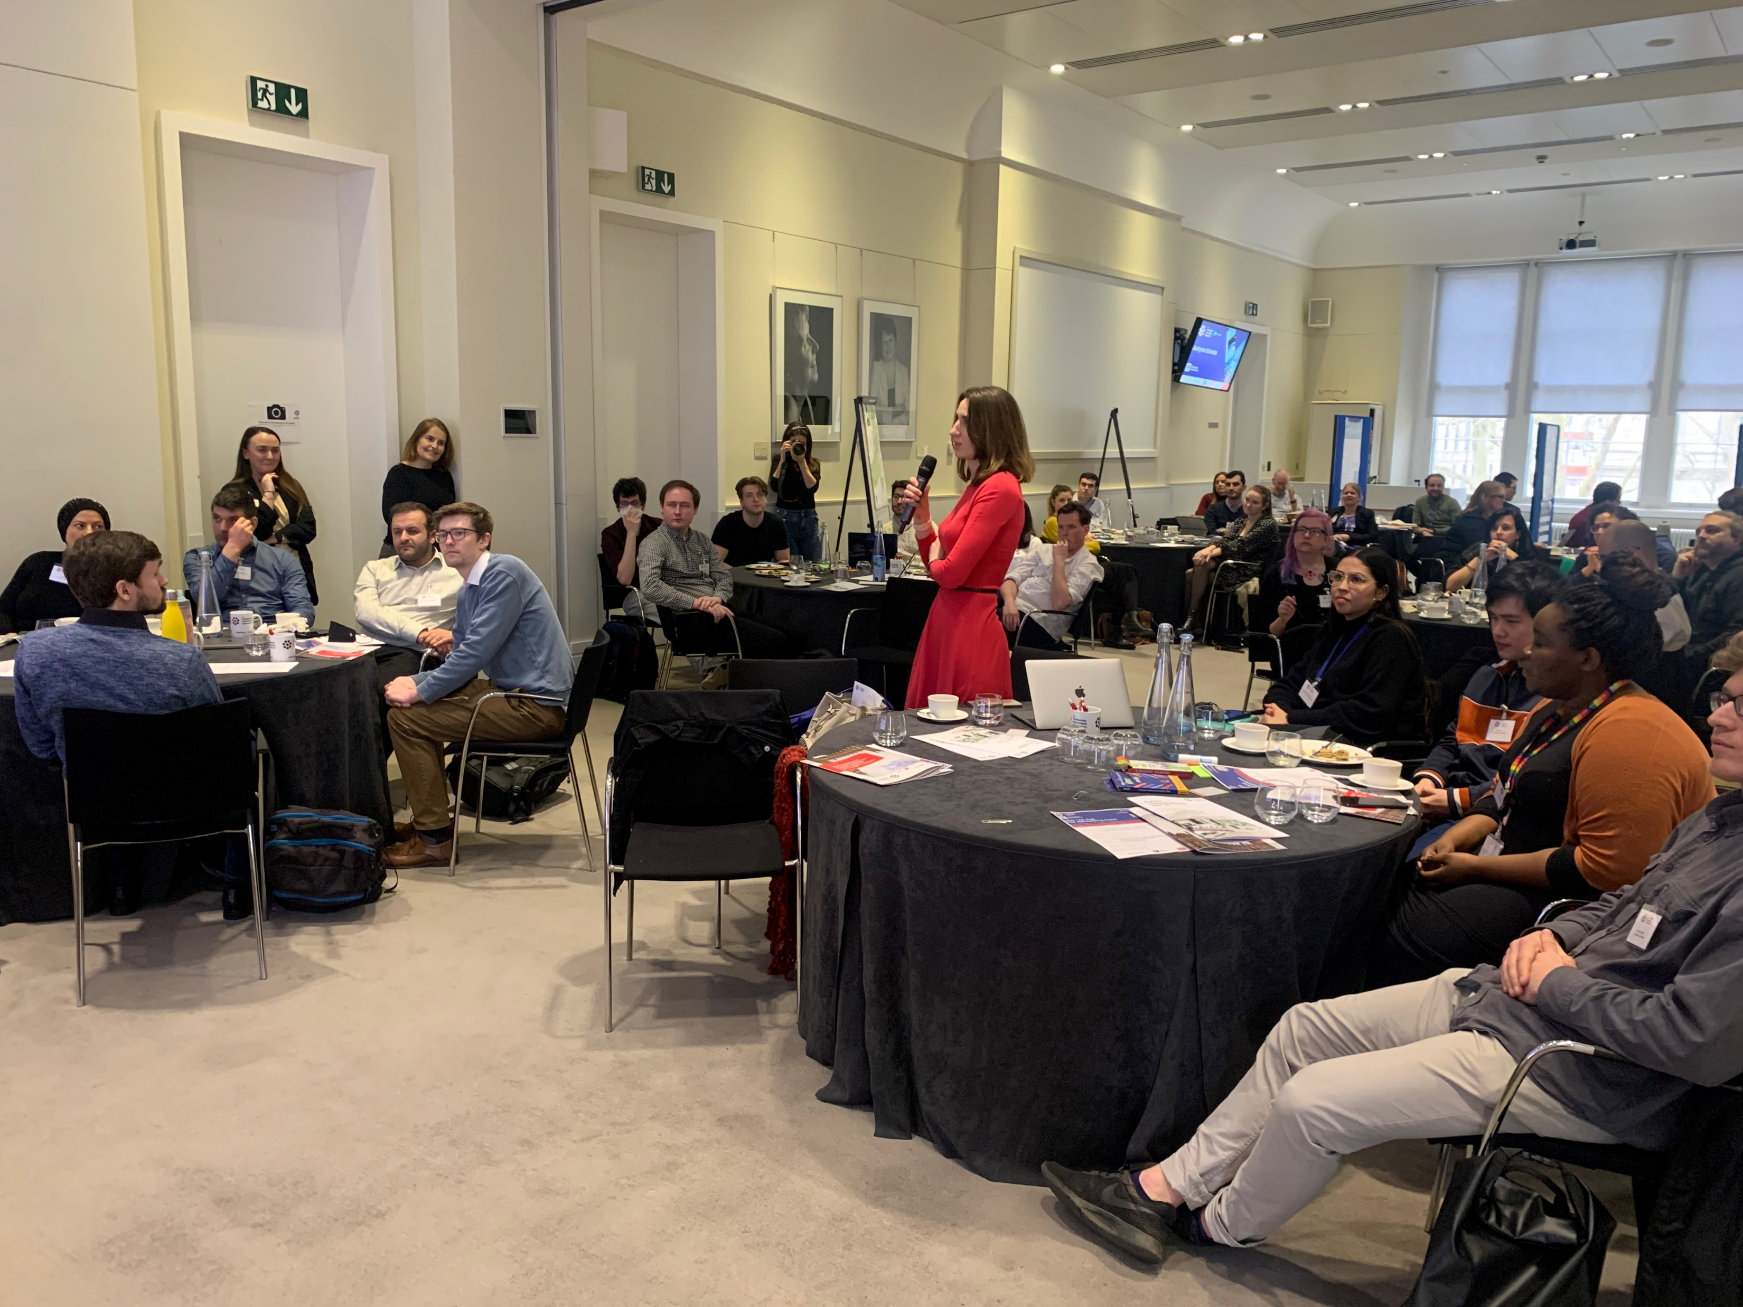
TAS Hub Priorities & Activities
Research
Advocacy & Engagement
Skills
Agile, Interdisciplinary,
Industry Collaboration
Policy Makers,
User Partners, Public
ECRs, Doctoral Training Network, Syllabus Lab
Creative Engagement & Media
Industry Partners & Govt
Training & Outreach
Notes:
Focii Research, A&E, and Skills.
Working with our creative partners, industry and government and making sure we translate our research into meaningful training and outreach.

Slide 7
Strategic Plan Overview
Phase 1: Initiate | Year: 1 & 2 | Initiate research projects, establish interdisciplinary research agenda through key engagements and promote EDI and RRI.
Phase 2: Grow | Year: 1,2,3 | Deliver impactful research for industry and government, grow partnerships with key stakeholders, initiate spin off projects and enterprise activities, and establish partnerships with international research centres.
Phase 3: Flourish | Year: 2,3,4 | Deliver best practices in the form of case-studies, best practice book, legal toolkits, creative outputs and establish TAS leadership across international venues (UN, academic and industrial conferences, etc..).
Notes:
Phase 1 was really about finding our feet
Phase 2 is well under way – starting to deliver impactful research, strengthening exisiting partnerships, establishing new ones.
Phase 3 is about delivering best practices, and going out and deliver thought leadership on a global stage

Slide 8
TAS Programme: Past and Present
Sept 2020
Nov 2020
July 2021
Sept 2021
July 2022
Research
Programme
Nodes Start
8 Agile Projects
12 PP1 Projects
US Visits
Resp. Projs. Start
8 PP2 Projects
15+ Int Projects
Advocacy & Engagement
Podcast Launched
TAS-RUSI Conf
TAS Convos
Swarm Workshop
Health & Care Conf
Robotics Workshop
Maritime Workshop
Policy Engagement
CMA
AVs
Mobility
Online Safety
Data Protection
Intellectual Property
Privacy
Connected Tech
Policy Lab on AVs
Skills Programme
DTN Launched
Skills Workshop 1
ECR Workshop
Syllabus Workshop
EDI
TAS Guide Principles
EDI WG
Agile RRI Workshop
EDI Survey
EDI SoI & Strategy
Notes:
We have all been very busy.
We started in 2020 and have initiated a number of activities along the strands you see here, Research … etc..
Highlight a few.

Slide 9
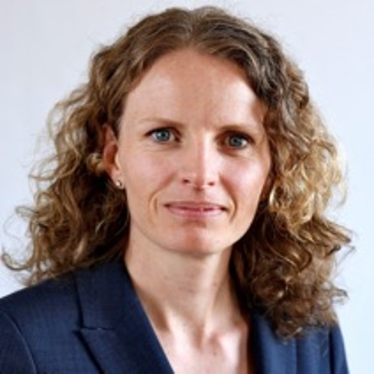
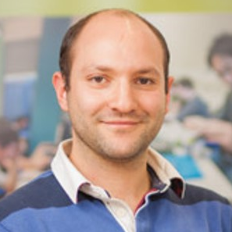
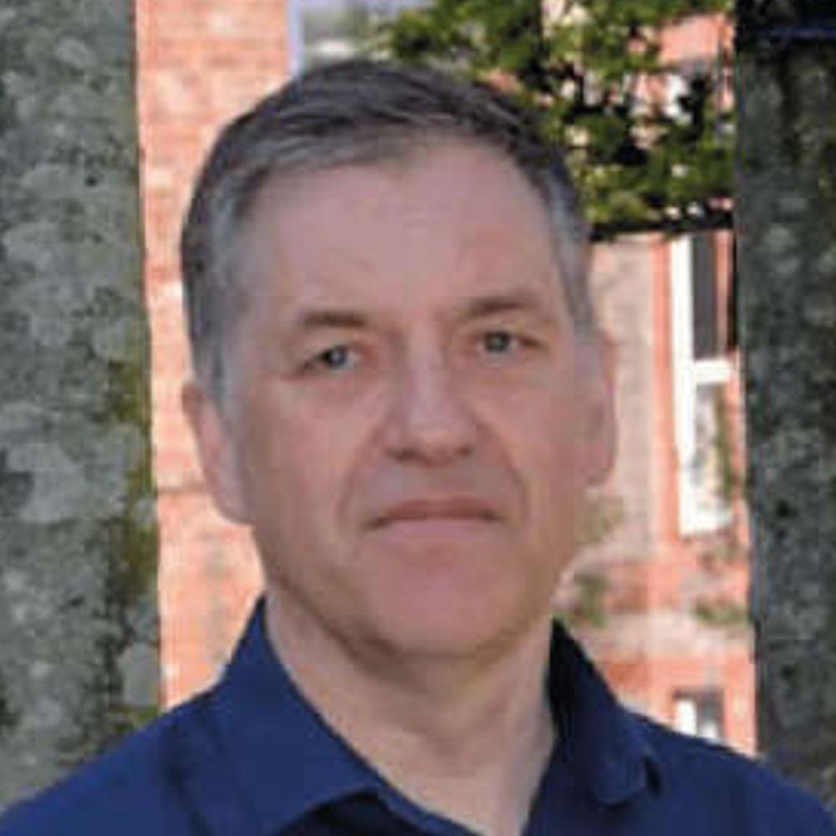
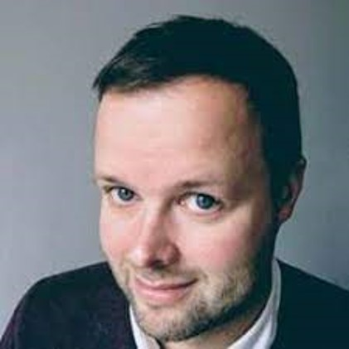
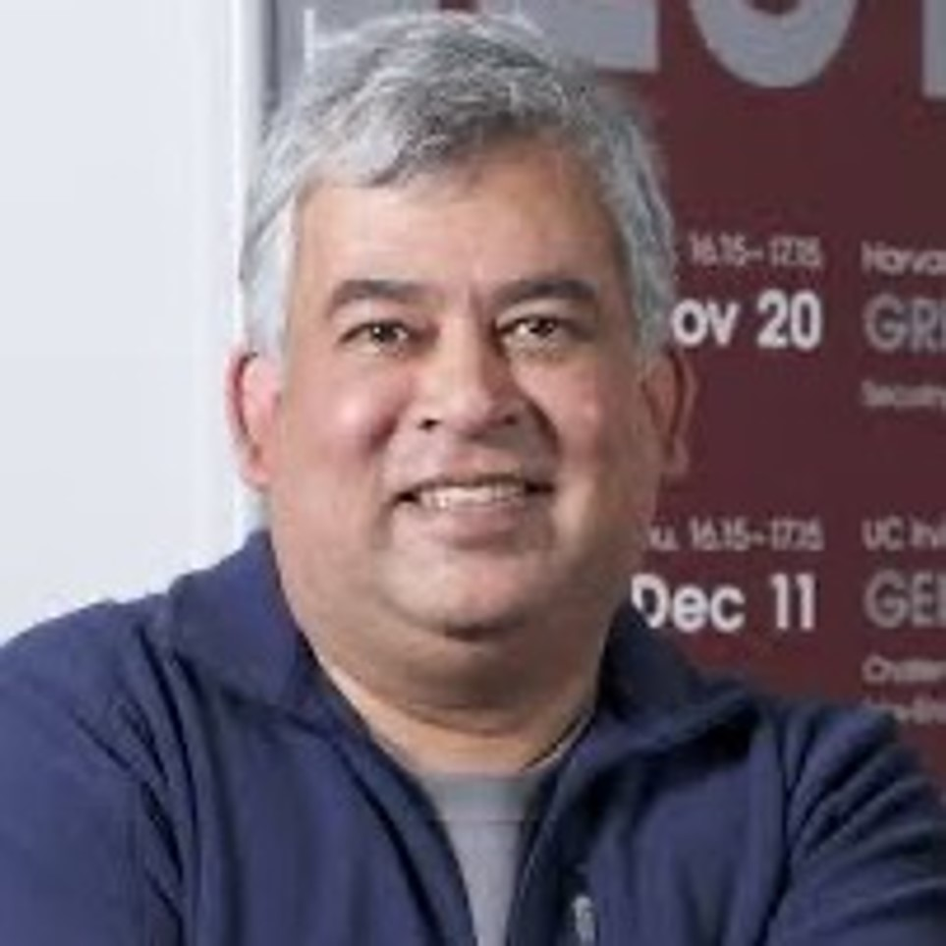
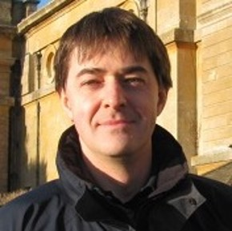
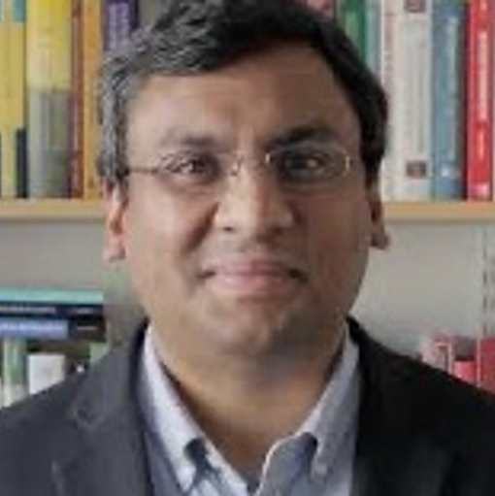
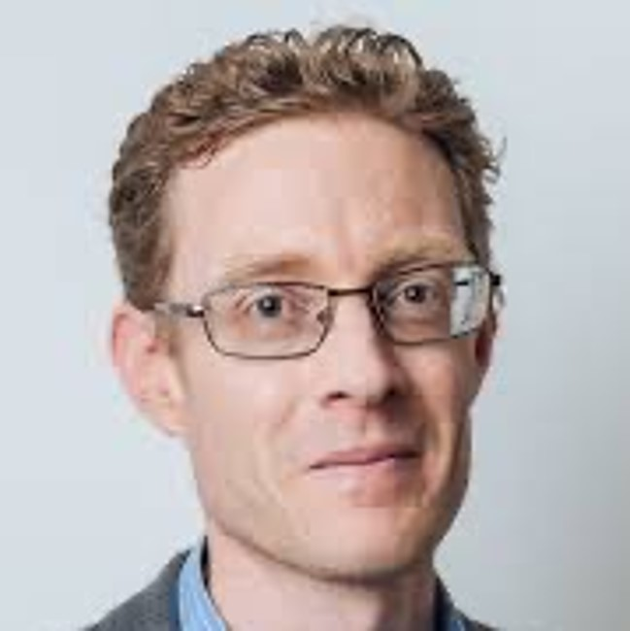
The TAS Network
The TAS Programme includes one hub, 6 nodes, 4 Responsibility projects, 20 Pump Priming Projects and 30+ Agile/Integrator Projects initiated by the Hub and the Network.
Trust
Responsibility
Security
University of Glasgow
University of Strathclyde
University of Edinburgh
Governance &
Regulations
Resilience
Lancaster University
University of Liverpool
Coventry University
University of York
TAS Hub
University of Sheffield (21 and 22)
University of oxford
University of Lincoln
University of Nottingham
University of west England
University of East Angia
Verifiability
Functionality
University of Hertfordshire
City University
Hub Institution
Alan Turing Institute
University of Bristol
University College London (21 and 22)
Lead Institution 21
Imperial College London
Lead Intuition 22
King’s College London
University of Southampton
University of Southampton
20 Pump Priming Projects (2021/2022)
Distribution of Pump Priming Projects (21/22)
30+ Agile/Integrator Projects (2021/2022)
Notes:
And this is who we’ve grown to be.
Highlight Agile/Integrator projects, Pump priming projects.

Slide 10
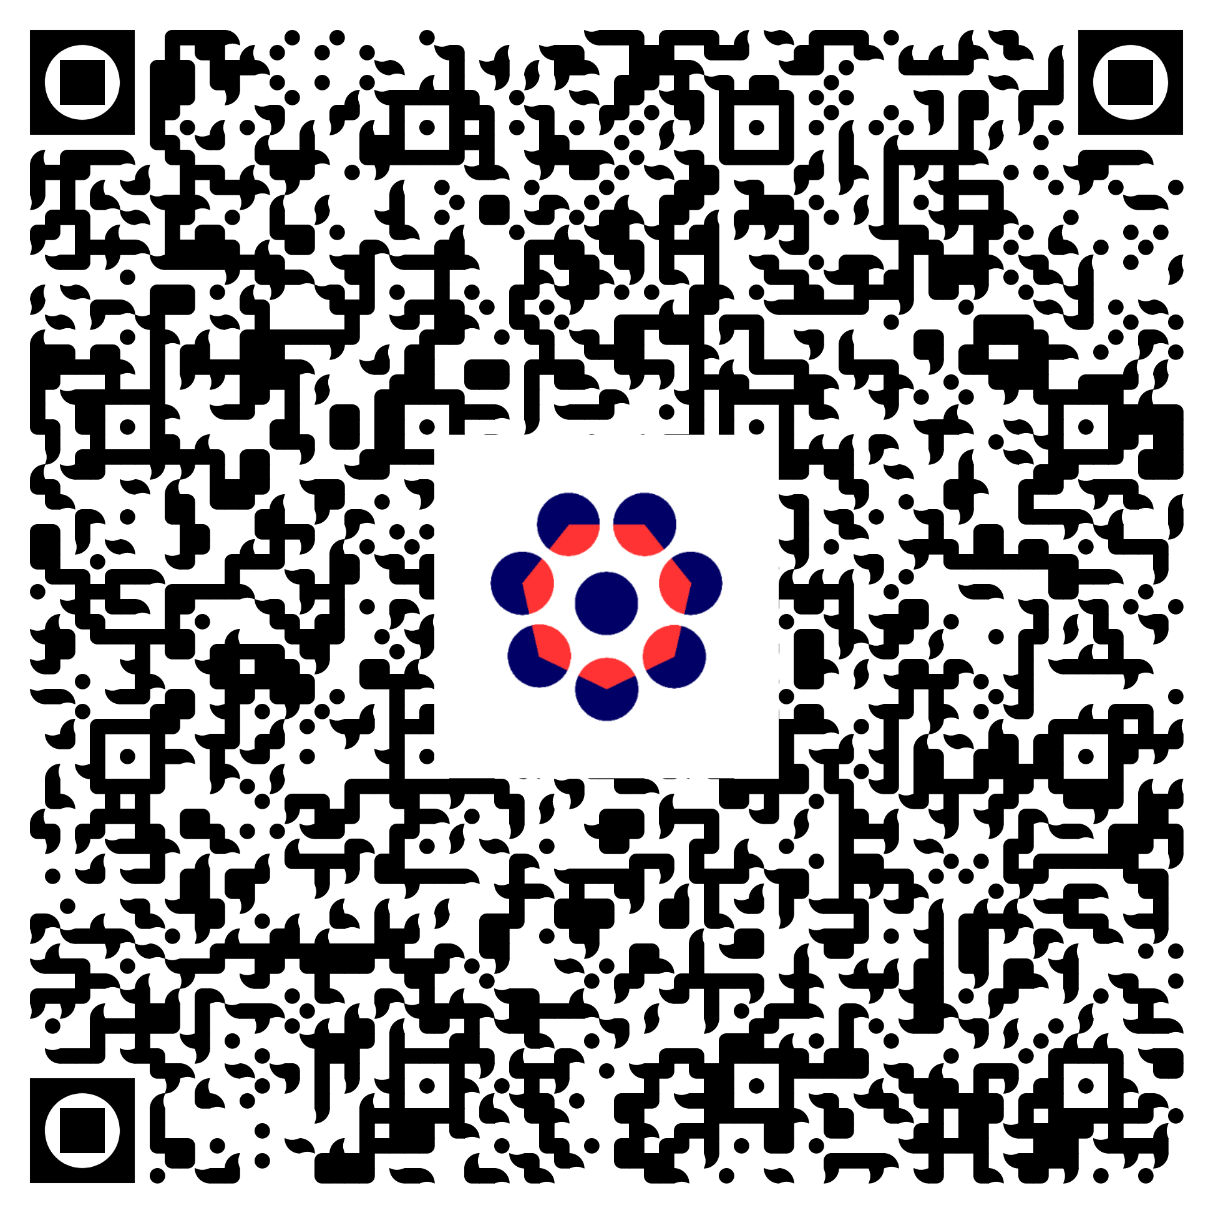
UKRI Trustworthy Autonomous Systems (TAS) Programme
Annual
Report 2022
Notes:
Find more details on our achievements in the annual report which you can download here.

Slide 11
What is AHM 22 about?
Celebrate
our successes, our resilience, recovery from COVID, new friendships, new ideas
Reflect
on our mistakes, gaps, our approach, and untapped potential
Anticipate
arising challenges, risks, and opportunities
Plan
our collaborations, research priorities, inclusion strategies
Notes:
Today is about generating fresh ideas for the rest of the programme, and even for new projects.

Slide 12
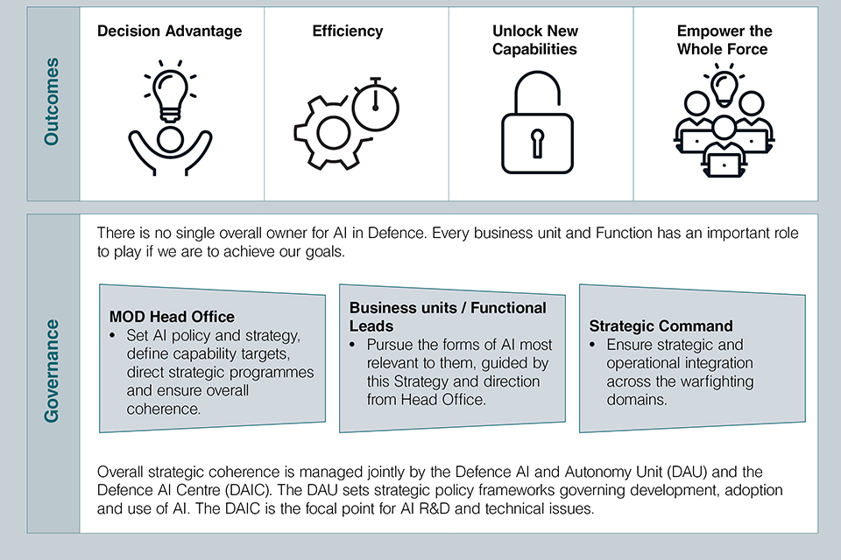
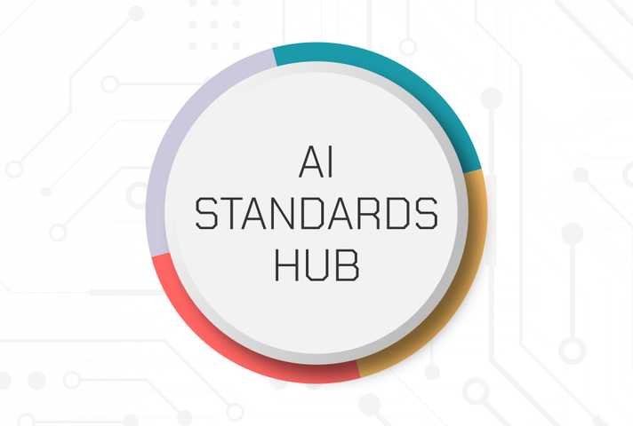
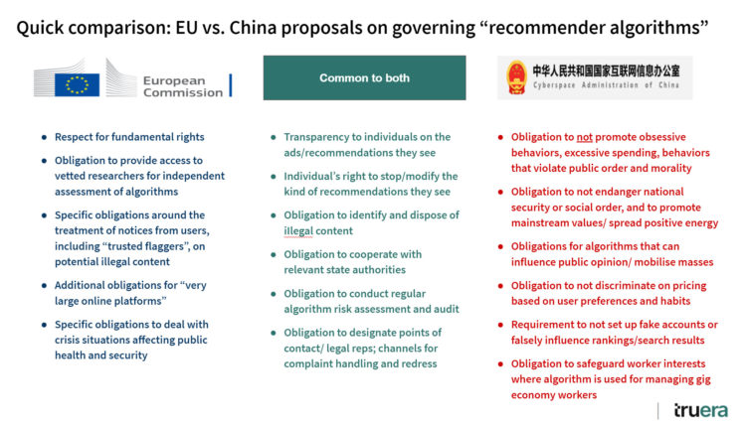
TAS Regulation & Standards Landscape
Notes:
Just as we’ve been operating so far we need to be agile… against a new landscape…

Slide 13
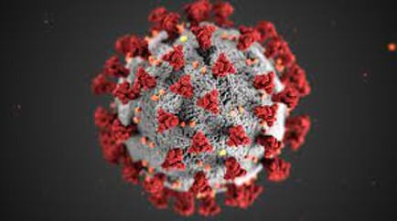
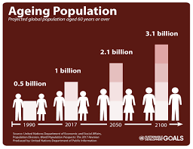
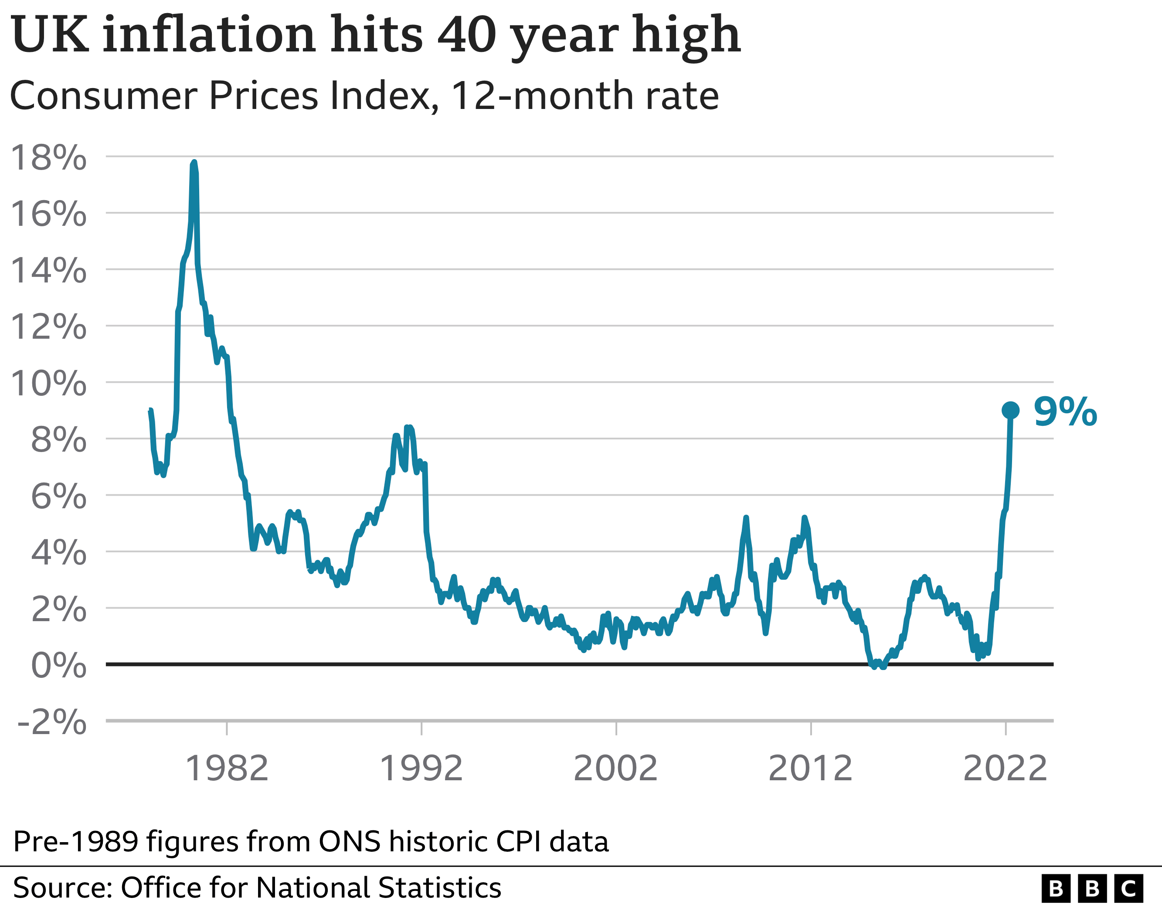
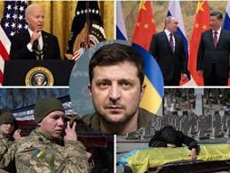
Global Challenges
Notes:
The world has changed and keeps changing significantly… The effects of the pandemic are still being felt… the war in ukraine will change our priorities.. Etc…
These are big problems that I think TAS may have solutions for.

Slide 14
Planned
Activities
Policy Labs
TAS Conference 2023
Logistics and Manufacturing Workshop (TAS-F led)
PP3 Call
(August for Nov. Deadline)
PP2 & Agile/ Int Launch
TAS Hub Global
Sandpit Pilot
TAS Skills Day (Nov 2022)
Podcast
Season 2
TAS Conversations
Legal Toolkit
TAS Visits
(Australia, Japan….)
Innovation Tournament for Grand Challenges
TAS School
Outreach Toolkit
Notes:
We are always pushing ourselves to do more… but we need all your help to make it happen.

Slide 15
Part 1
Setting the Scene
Part 2
Reflect, Anticipate and Plan
Overview by UKRI Head of Artificial Intelligence and Robotics , Dr James Dracott Main Hall
Introduction to the TAS Hub Research Programme , Professor Joel Fischer, TAS Research Director Main Hall
Research Highlights
TAS Research Programme Panel chaired by Professor Joel Fischer, TAS Research Director. With Professor Radu Calinescu, Carly Kind, and Dr Kate Devlin. Main Hall.
Live exhibition of TAS research, demos, policy, and creative work. Lutyens Suite
TAS Creative Ambassadors: Blast Theory
Translating TAS Research.” Panel chaired by Professor Derek McAuley, TAS Deputy Director Professor Dame Wendy Hall, Dr Ben Pritchard (Thales), Miranda Marcus (BBC) and Professor Tom Rodden (DCMS)
“International Perspectives on TAS” chaired by Professor Sarvapali Ramchurn, TAS Director.​ Professor Subramanian Ramamoorthy, Professor Milind Tambe, Dr Cara LaPointe and Professor Sharon Strover.
Email your questions, thoughts, suggestions to: contact@tas.ac.uk
Notes:
So today will hopefully help us plan for the next phase..
There will be two parts. Scene Setting and then panels, exhibitions etc..

Slide 16
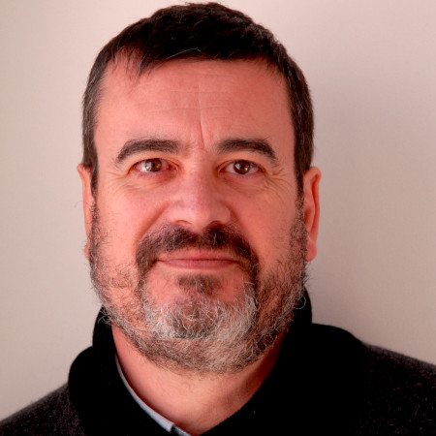
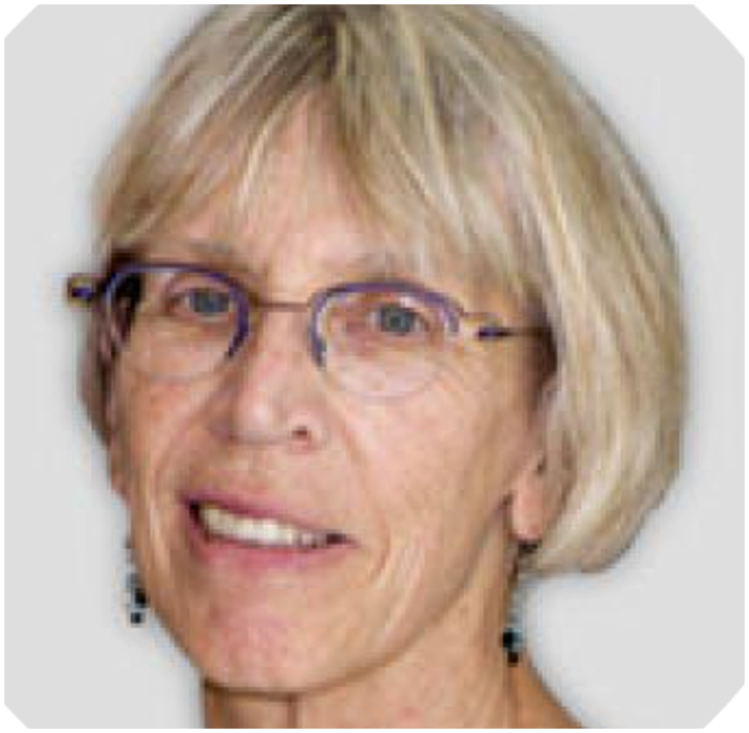
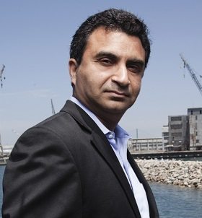
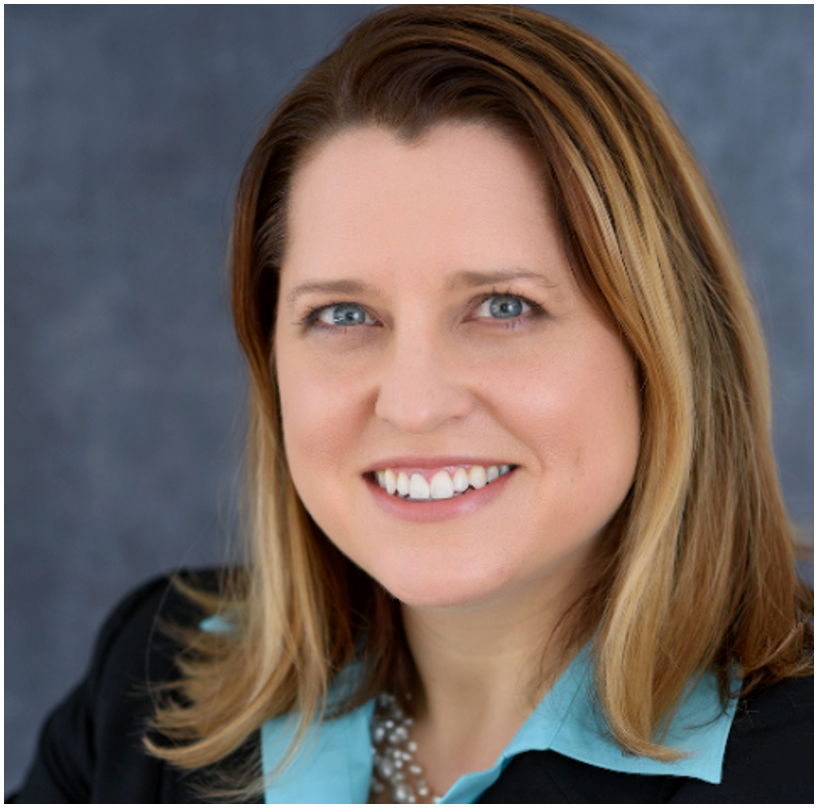
International
Guests
Professor
Carles Sierra
Professor
Sharon Strover
Professor
Milind Tambe
Dr. Cara
LaPointe
Director, IIIA, Spain
Director, Good Systems, USA
Director CRCS-Harvard, USA
Co-Director JHU IAA, USA
Notes:
I’d like to thank our international guests who have taken the trouble to come to London in this horrible weather…
They will be involved on various panels throughout the day to give us their perspectives on TAS priorities.

Slide 17
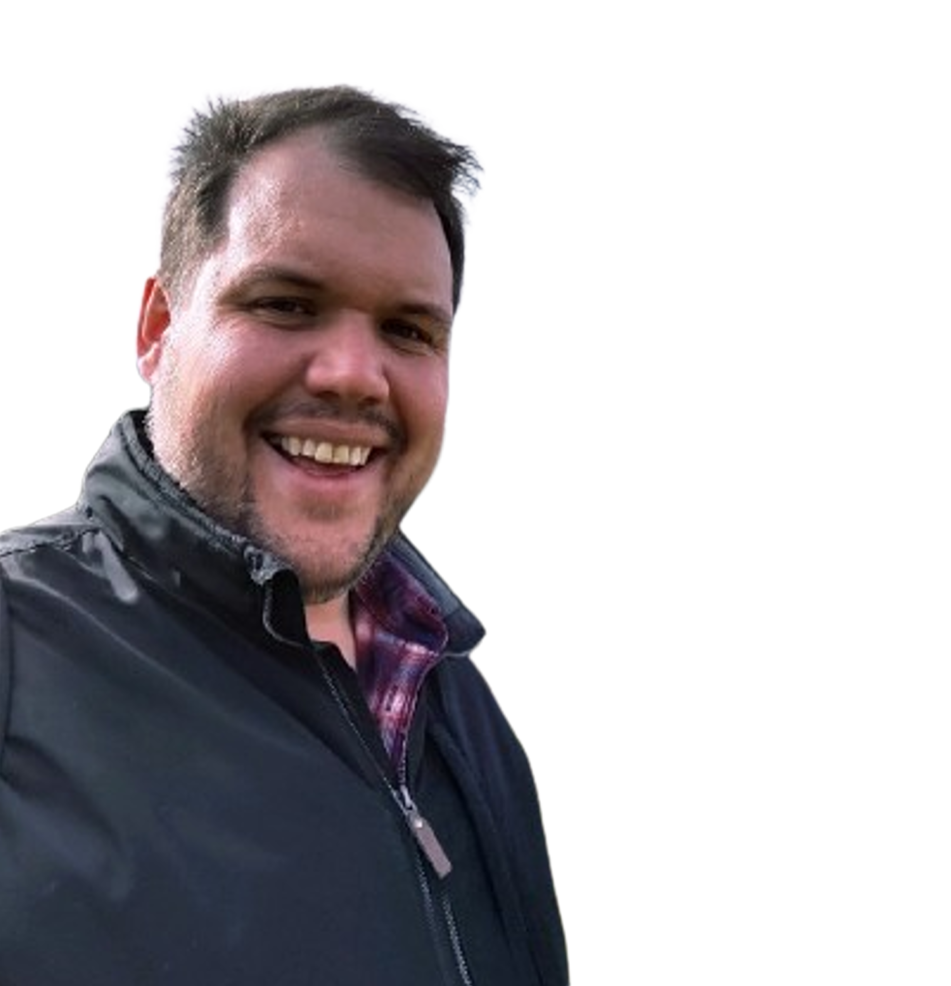
Next Talk: An Overview of AI and Robotics
Dr. James Dracott
Head of AI and Robotics at the Engineering and Physical sciences Research Council, part of UK Research and Innovation. James has worked across the research councils in various roles including setting up the Future Leader Fellowships scheme and as head of the Information and Communications Technologies theme.
Notes:
Let me introduce the next speaker.

