Slide 2
UKRI Strategy and priorities
Transforming tomorrow together
UKRI Strategy
Relevant UK national strategies
AI across UKRI

Slide 3
UK Research and Innovation
We work with the government to invest over £7 billion a year in research and innovation by partnering with academia and industry to make the impossible, possible.
The UKRI Strategy:
Covers the period 2022-27, corresponding to the period for reaching the government’s R&D public spending target of £22 billion per annum
Reflects UKRI’s role as an essential connecting institution between researchers and innovators, governments, investors, and communities
Involves working in more collaborative, effective and efficient ways, with improved connections across UKRI, and a new operating model

Slide 4
UKRI Strategy – how it all fits together
Our purpose – transforming tomorrow together
Our strategy sets out how we will work with our many partners and stakeholders to foster an outstanding research and innovation system in the UK that drives economic, social, environmental and cultural benefits for all citizens, transforming tomorrow together.
Our principles for change – we will embed these principles across all our work, to drive change and create the conditions for an outstanding research and innovation system
Diversity of ideas, people, activities, skills, institutions and infrastructures advances knowledge, increases quality and creativity. | Resilience ensures the agility, capability, and flexibility needed to withstand shocks, deliver focus long-term goals and capture new opportunities.
Connectivity across disciplines, sectors and borders catalyses new ideas and approaches to deliver impact. | Engagement shapes research and innovation to reflect the needs, perspectives and motivations of diverse stakeholders and the public.

Slide 5
People and careers | Places | Ideas | Innovation | Impacts
1.1 Make the UK the most attractive destination for talented people and teams from the UK and around the world 1.2 Develop the breadth of skilled people and teams essential for the future R&D workforce 1.3 Shift research culture to support, rather than hinder, talented people and teams to pursue their ideas | 2.1 Strengthen clusters and partnerships – locally, nationally and globally 2.2 Improve the financial sustainability of research and innovation in organisations across the UK 2.3 Secure cutting-edge infrastructures for world-class research and innovation | 3.1 Invest in a diverse and dynamic portfolio of high-quality, creative research and innovation 3.2 Incentivise and remove barriers to multi- and inter-disciplinary working | 4.1 Deliver the skills, finance and collaboration opportunities needed to boost private sector investment 4.2 Accelerate translation, commercialisation and knowledge exchange | 5.1 Address major national and global challenges Building a green future Securing better health, ageing and wellbeing Tackling infections Building a secure and resilient world Creating opportunities, improving outcomes 5.2 Harness the opportunities from tomorrow’s technologies 5.3 Transform sectors that are key to the future economy
Supported by a world-class organisation – making UKRI the most efficient, effective and agile organisation it can be. 6.1 Empower talented people to collaborate and thrive 6.2 Make UKRI an efficient, effective and agile organisation 6.3 Catalyse change and impact through partnership and leadership
Our Strategic Objectives and Priorities
Each strategic objective will be delivered through a set of priorities for UKRI over the next five years.

Slide 6
Delivering the UKRI Strategy: total funding allocations 2022-23 – 2024-25

Slide 7
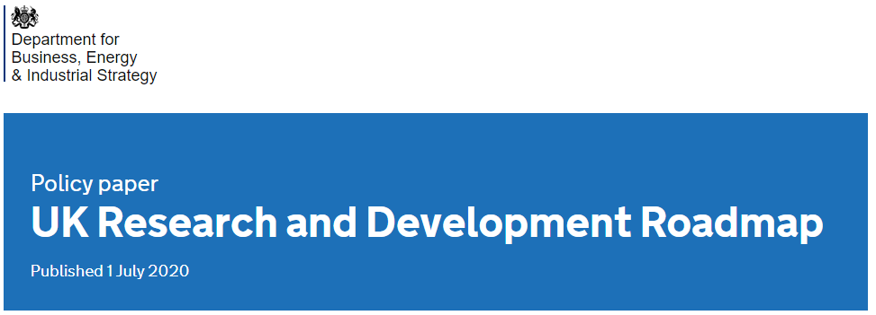
UK R&D Roadmap
The Research and Development Roadmap, published on 1 July 2020, puts pursuing ground-breaking research, attracting global talent, and cutting unnecessary red tape at the forefront of the Government’s long-term plan to ensure the UK is the best place in the world for scientists, researchers and entrepreneurs to live, work and innovate.
It recognises the Governments’ ambition to increase investment in R&D to 2.4% of GDP by 2027 and commits to increase public funding for R&D to £22bn per year by 2024 to 2025
It focuses on tackling big challenges of today including achieving net zero

Slide 8
UK Integrated Review
Integrated Review of Defence, Security, Development and Foreign Policy
“Keeping the UK’s place at the leading edge of science and technology will be essential to our prosperity and competitiveness in the digital age. Our aim is to have secured our status as a Science and Tech Superpower by 2030, by redoubling our commitment to research and development, bolstering our global network of innovation partnerships, and improving our national skills – including by attracting the world’s best and brightest to the UK through our new Global Talent Visa” – The Prime Minister
Key points
Build on the UK’s successful S&T Base
Improving and accelerating the ‘pull through’ from research to commercialisation
Better protect our intellectual property and sensitive research
Improve our ability to identify, build and use the UK’s strategic S&T capabilities
Build a strong and varied network of international S&T partnerships

Slide 9
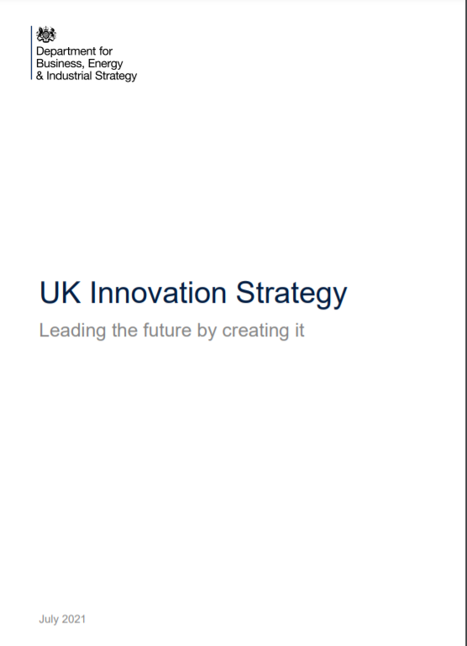
UK Innovation Strategy
UK Innovation Strategy: Leading the future by creating it
Sets out the vision for the UK to be a global hub for innovation by:
Unleashing business –fuel businesses who want to innovate
People - make the UK the most exciting place for innovation talent
Institutions and places - ensure our research, development and innovation institutions serve the needs of businesses and places across the UK
Missions and technologies –stimulate innovation to tackle major challenges faced by the UK and the world and drive capability in key technologies
Built around 7 technology families of UK strength and opportunity:
Advanced Materials and Manufacturing
AI, Digital and Advanced Computing
Bioinformatics and Genomics
Engineering Biology
Electronics, Photonics and Quantum
Energy and Environment Technologies
Robotics and Smart Machines

Slide 10
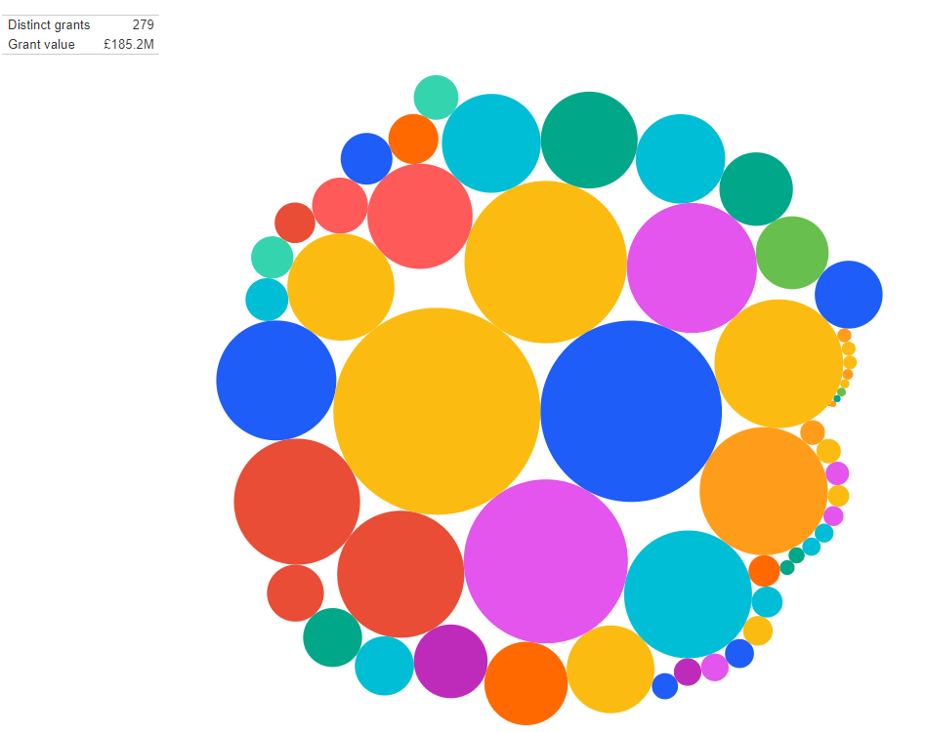
The Future of AI

Slide 11
Strategic advantage through the National AI Strategy
UKRI have worked closely with the Office for AI to develop the UK’s National AI strategy
Supporting proven growth levers:
Skills and Talent
R&D
Data
Compute
Finance and VC
Investing in the Long Term Needs of the AI Ecosystem
Working with our international partners to embed AI governance values shared by the UK
Diversity & Public Trust
Making AI accessible to industries and businesses across the whole country
A world-leading domestic regulatory model that balances innovation and risk
Ensuring AI Benefits All Sectors and Regions
Governing AI Effectively
Using AI for the public benefit in service of bold missions

Slide 12
UKRI’s Approach to AI
AI is a key strategic priority technology for the UK, it shows huge potential to transform society, the economy, and help us tackle environmental challenges
Through the UKRI AI Review we have sought to understand the complex UK AI R&I landscape, and to set out a clear vision and ambition for the role of the research and innovation community and our plans to support AI research
The UKRI Statement of Opportunities on AI in conjunction with the National AI strategy sets our vision and aspirations to support a world leading, highly interconnected & interdisciplinary UK research & innovation ecosystem
Now we will build on our existing investments, working with stakeholders to develop plans for supporting AI research and innovation, and build towards a unified UKRI AI Programme

Slide 13
Strong foundations
The current UKRI AI Portfolio totals just over £1billion delivered through circa 700 grants, not including significant Innovate UK funding to businesses.
Over 60% of these are addressed at core engineering and physical sciences research, with an overall split of around 50/50 between fundamental AI development and applications of the technology
This investment leverages £332million of additional investment from industry and government partners.

Slide 14
Our goals:
Building an ecosystem
For the UK to remain at the forefront of AI research and deliver on it’s promise for society, the whole ecosystem needs to work connect AI researchers, innovators and practitioners
We will build connections between existing investments and fund new centres of excellence and hubs to create cross disciplinary and cross sector ecosystem, connecting researchers, innovators, and practitioners of AI.

Slide 15
Looking to the Future
The UKRI Statement of Opportunities on AI sets out our vision for supporting an interconnected ecosystem of AI research and innovation, focussed on:
Creating the environment for AI research and innovation
Promoting world-leading AI research & innovation
We will use our framework to build towards a national multidisciplinary UKRI AI programme which spans an ecosystem of collaborating and connected business, university, public and third sector stakeholders
Notes:
.

Slide 16
@UKRI_news
UK Research and Innovation
UK Research and Innovation

