Slide 1
Trust in Human-Swarm Teaming
TAS Hub All Hands Meeting, July 2022
Dr Mohammad Soorati
Assistant Professor of AI,
School of Electronics & Computer Science,
University of Southampton

Slide 2
Career Path
Evolutionary Robotics
Human-Swarm Teaming
Human-AI interaction
Computer Science
Human-Machine Teaming
Computer Science
BSc
Dr Eng
Research Co-I
MSc
Post-doc
Lecturer
Software Engineering
Computer Engineering
TAS Hub
Swarm Optimisation
Swarm Robotics

Slide 3
Projects
✓
florarobotica (EU Horizon 2020)
Duration: Apr 2016 – Dec 2019
Role: PhD researcher
Flexible Autonomy of Robot Swarms (Alan Turing Institute)
Duration: Aug 2019 – Dec 2020
Role: Research Fellow
Trustworthy Human-swarm Partnership in Extreme Environments (TAS Agile Project I)
Duration: Jan 2021– Feb 2022
Role: PI
Academic Partners: +15 Academic & Researcher Staff (Southampton, King’s College, Nottingham)
Industry Partners: Thales, Dstl, QinetiQ
XHS: eXplainable Human-swarm Systems (TAS Agile Project II)
Duration: Jul 2022– Jun 2023
Role: PI
Academic Partners: 16 Academic & Researcher Staff (Southampton, King’s College, Uni Texas at Austin, Glasgow, Bristol)
Industry Partners: Thales, Dstl
Smart Solutions Towards Cellular-Connected Unmanned Aerial Vehicles System (EPSRC)
Duration: Aug 2022 – Jul 2025
Role: Co-I
Academic Partners: 9 Researchers (Southampton, King’s College, Queen Mary)
Industry Partners: Thales, AccelerComm, Airborne Robotics, Ericsson, Northrop Gruman (UK), Toshiba
✓
✓
●
●

Slide 4
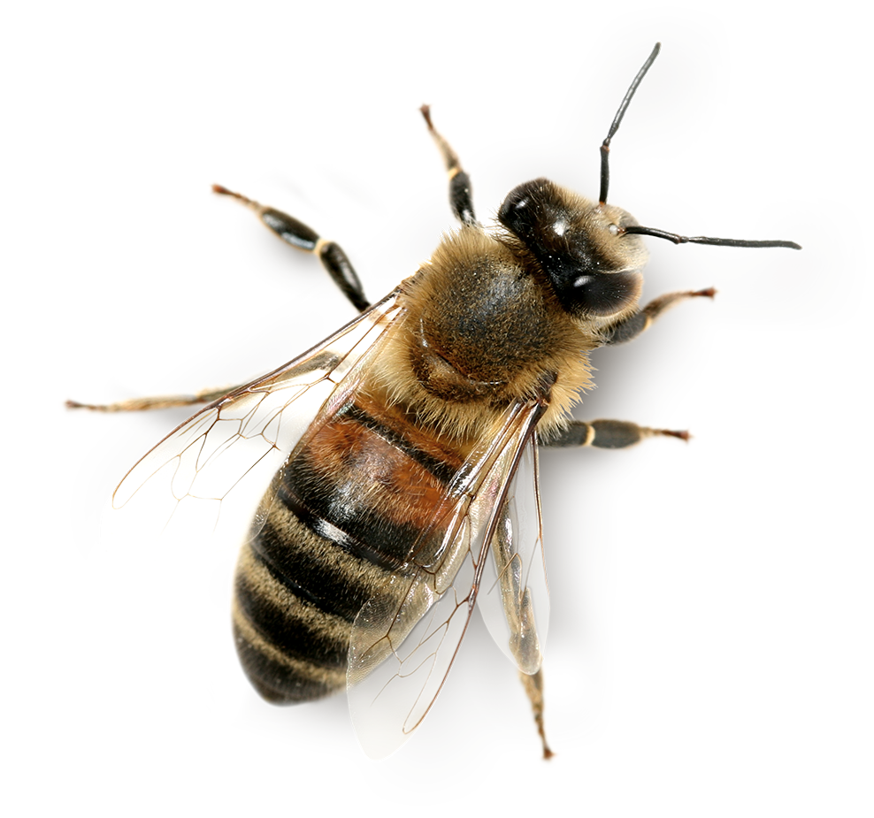
My Research
Why Swarm Robotics?
No single point of failure
Communication does not exist, is likely to fail or is not allowed
Synchronized & certain information is unavailable
Sophisticated Sensors are not working
Failure is Expensive
Limited Communication
Uncertain
Sensor Failure
Swarm Robotics
Anonymous agents in large groups that may not have access to global information

Slide 5
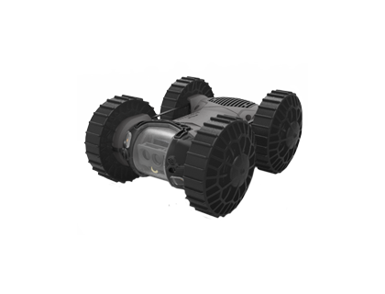
Swarm Robotics
Advantages
Challenges
Anonymous simple agents in large groups that may not have access to global information
Robustness
Critical Decisions
Adaptivity
Real World Usecase
Scalability
Explainability
Performance

Slide 6
Human-swarm Teaming
Advantages
Challenges
Robustness
Critical Decisions
Adaptivity
Real World Usecase
Scalability
Interface
Critical Decisions
Trust
Real World Usecase
Explainability
Performance

Slide 7
Research Agenda
Agile I & before
Agile II
Agile II & beyond
Online Simulation Platform | Verification of Feasibility, Risk & Trust | Self-organized Control Structure (Hybrid of centralized & decentralized)
User-centered Interface Design | Dynamic Interface (What, When, How, Why) | Brain electrodes (doubts, workload) & VR
Trust Requirements | Operators’ Perception of Trust w/o communication | Responsibility Allocation
Use-case Co-Creation with Thales & Dstl |  | Collective Perception & Learning with Heterogenous Swarm
Experts view on Explainability
Decision making with Limited Communication
I
T
E
P
I
I
E
I
T
T
I
T
U
U
E
P
I
nterface
T
rust
E
xplainability
P
erformance
U
secase

Slide 8
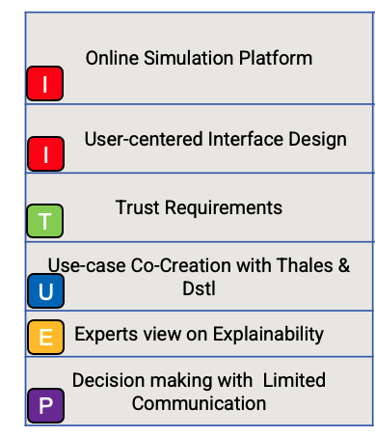
Agile Project I & Before
Disaster management with multi-operator human-swarm interaction
Multi-layer view, heatmap vs individual display
Experts view on trustworthy swarms
Industry-led use case for human-swarm interaction
Swarm robotics experts view on explainable swarms
Swarms resilience to communication limitation
I
nterface
T
rust
E
xplainability
P
erformance
U
secase

Slide 9
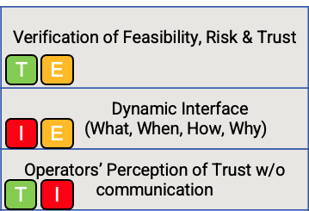
Agile Project II
Model checking to verify the probability of success, risk & trust issues
Interface that adapts to the situation to only display the information that is needed in usable way
Effect of communication in operators trust of the swarm and the team mates
I
nterface
T
rust
E
xplainability
P
erformance
U
secase

Slide 10
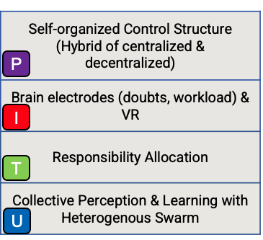
Agile Project II & Beyond
Emerging tree structures based on the criticality of tasks
Measuring human operator’s doubts, workload with brain electrodes & VR
Responsibility measurement with different task allocation methods
Human-in-the-loop collective decision making with heterogenous swarms
I
nterface
T
rust
E
xplainability
P
erformance
U
secase

Slide 11
Acknowledgement
Mohammad Naiseh
Jediah Clark
William Hunt
Katie Parnell
Maria Galvez Trigo
Thomas Kelly
Ashley Pare
Danesh Tarapore
Mario Brito
Katie Plant
Shalaka Kurup
Joel Fischer
Gopal Ramchurn
Michele Sevegnani
Blair Archibald
Vahid Yazdanpanah
Luis Sentis
Heeyong Huh
Junhyeok Ahn
Oliver Lanning
Steve Meers
Ben Pritchard
Miguel Massot
Adrian Bodenmann
Mohammadreza Mousavi
Sabine Hauert

Slide 12
Thank you
M.Soorati@soton.ac.uk

