Slide 1
AI for Social Impact
Milind Tambe
Harvard, Google Research
@MilindTambe_AI

Slide 2
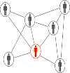
Lesson #1: Achieving Social Impact and AI Innovation Go hand-in-hand
Social
Networks &
Bandits
Multiagent
Systems
Research
Green
security
games
Public Health
Conservation
Public Safety
& Security
Stackelberg
security
games

Slide 3
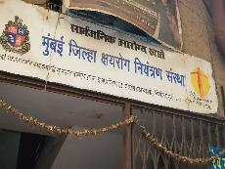
Lesson #2: Partnerships with Communities, NGOs (non-profits), governments crucial
Empower communities to use AI tools; avoid being gatekeepers to AI4SI technology

Slide 4
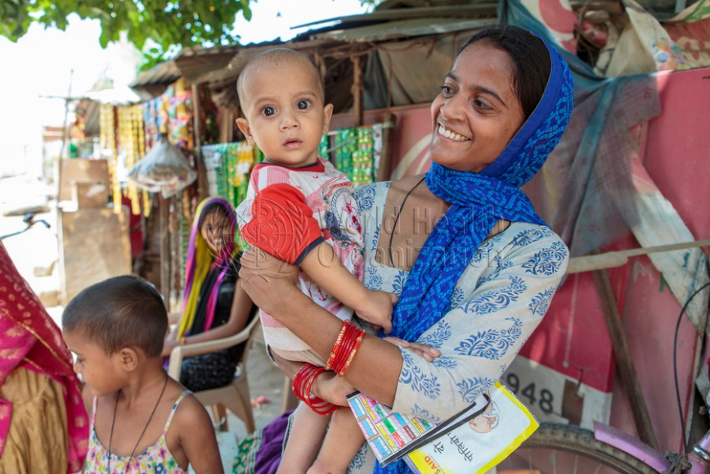
United Nations Sustainable Development Target
By 2030, maternal mortality ratio below 70 per 100,000 live births
Maternal Mortality Ratios (2017)
Credit: WHO SEARO
*UNICEF, 2022
Notes:
A woman dies in childbirth every 15 minutes in India.
India accounts for more than 11% maternal deaths globally.
2 children under age 5 die every minute in India.
4 out of 10 children are too thin or short for age

Slide 5
Maternal & Child Care in India
26 Million beneficiaries (mothers)
Notes:
A woman dies in childbirth every 15 minutes in India.
India accounts for more than 11% maternal deaths globally.
2 children under age 5 die every minute in India.
4 out of 10 children are too thin or short for age

Slide 6
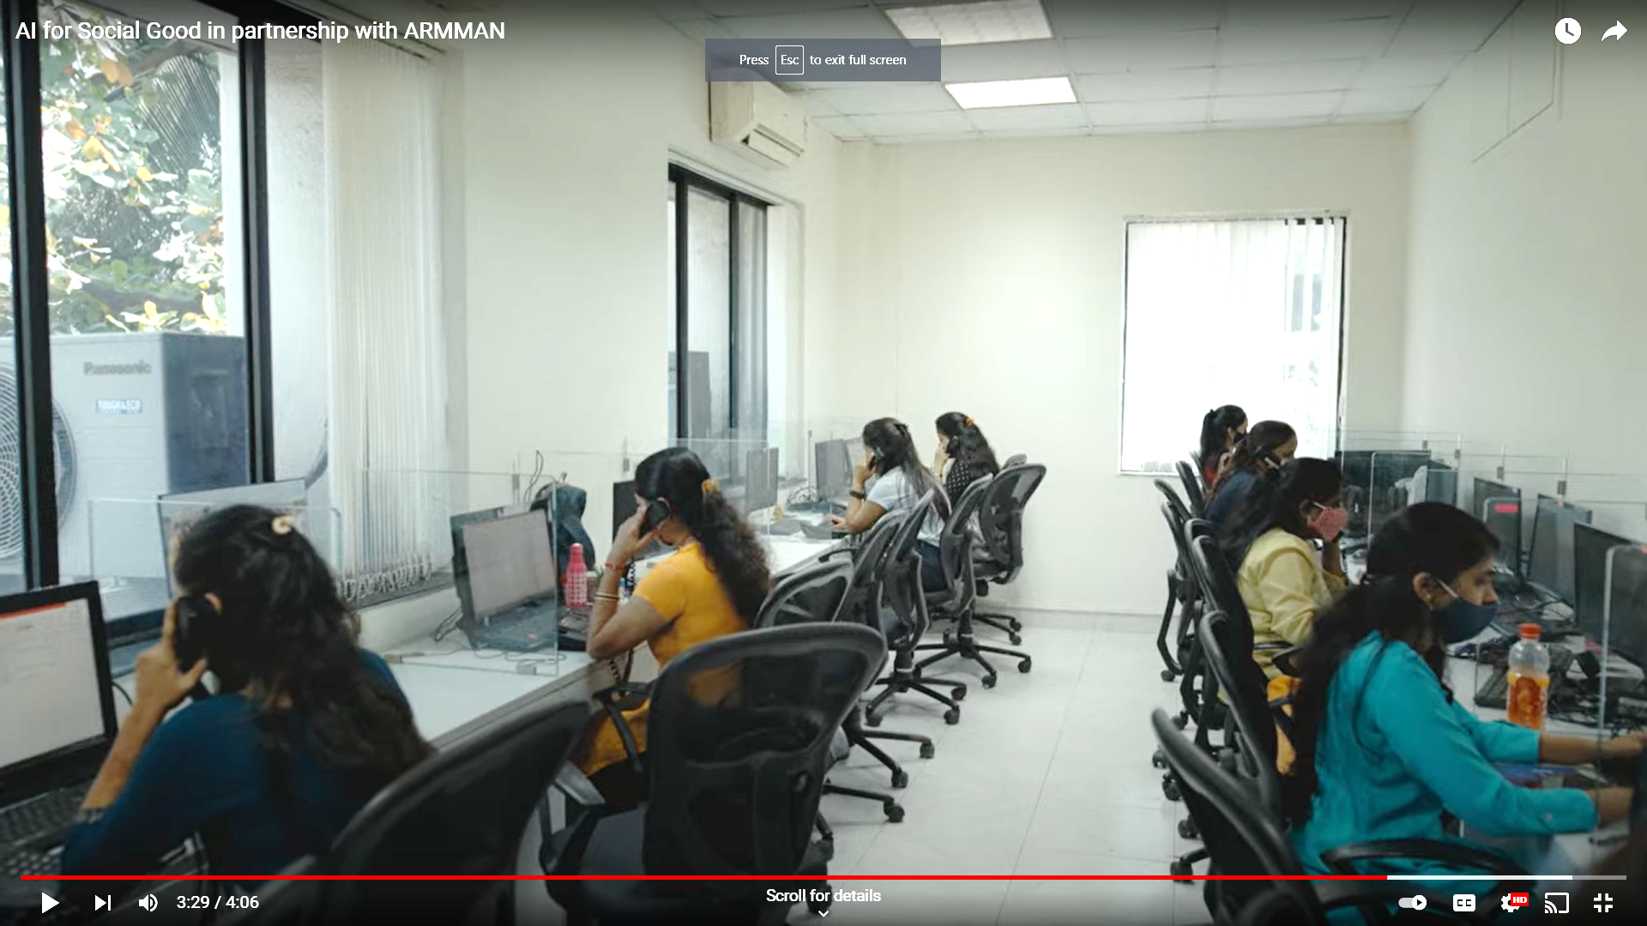
ARMMAN Health Program Adherence
Ensure adherence to health program
Weekly 2 minute automated message to
new/expecting moms
Unfortunately, 30-40% may become low-listeners
Limited resources: Service call to small number of beneficiaries
Pinpoint which beneficiaries (mothers) should receive a service call
Developed an AI model (Restless bandit -- RMAB):
Notes:
A woman dies in childbirth every 15 minutes in India.
India accounts for more than 11% maternal deaths globally.
2 children under age 5 die every minute in India.
4 out of 10 children are too thin or short for age

Slide 7
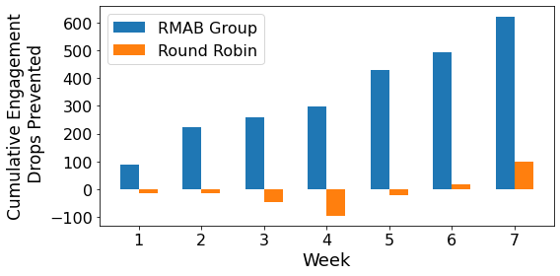
Results of 23000 Beneficiary Field Study (AAAI 2022)
First large-scale application: restless multiarmed bandits (RMAB) for public health
AI algorithm leads to 30% reduction in drop off rates over current standard of care

Slide 8
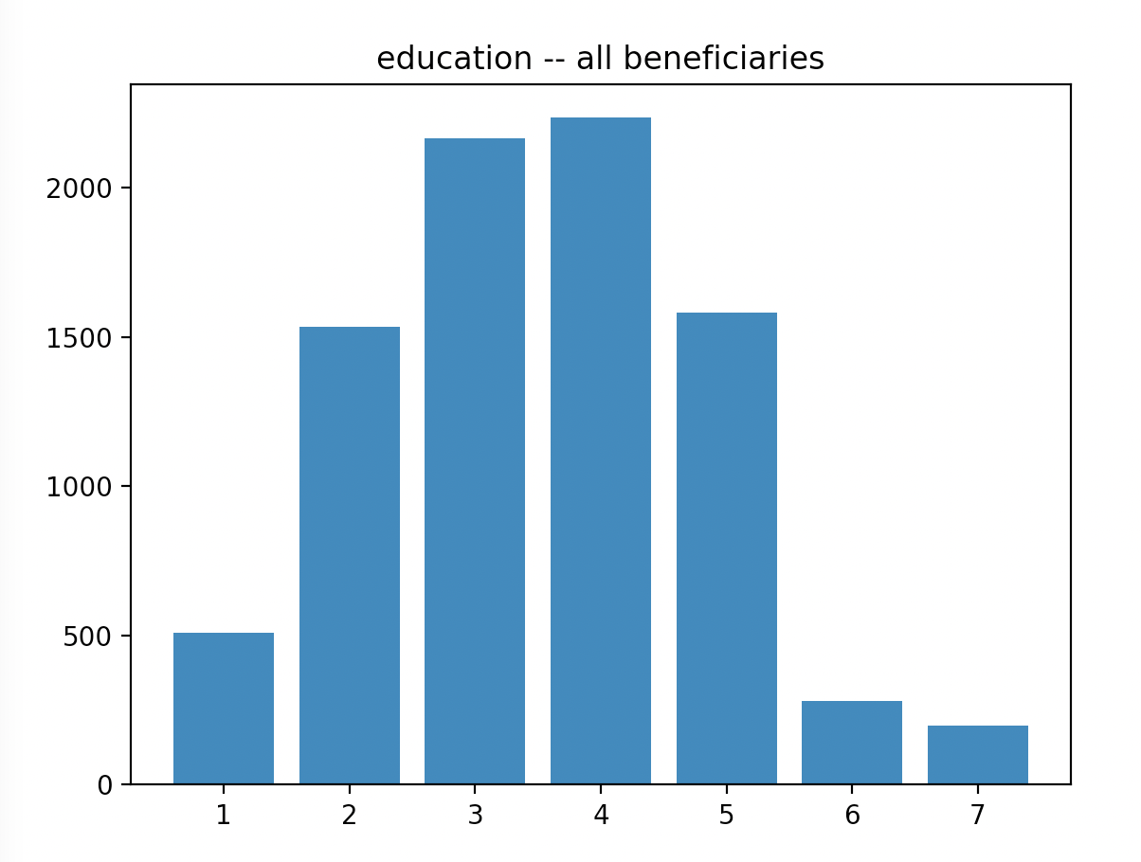
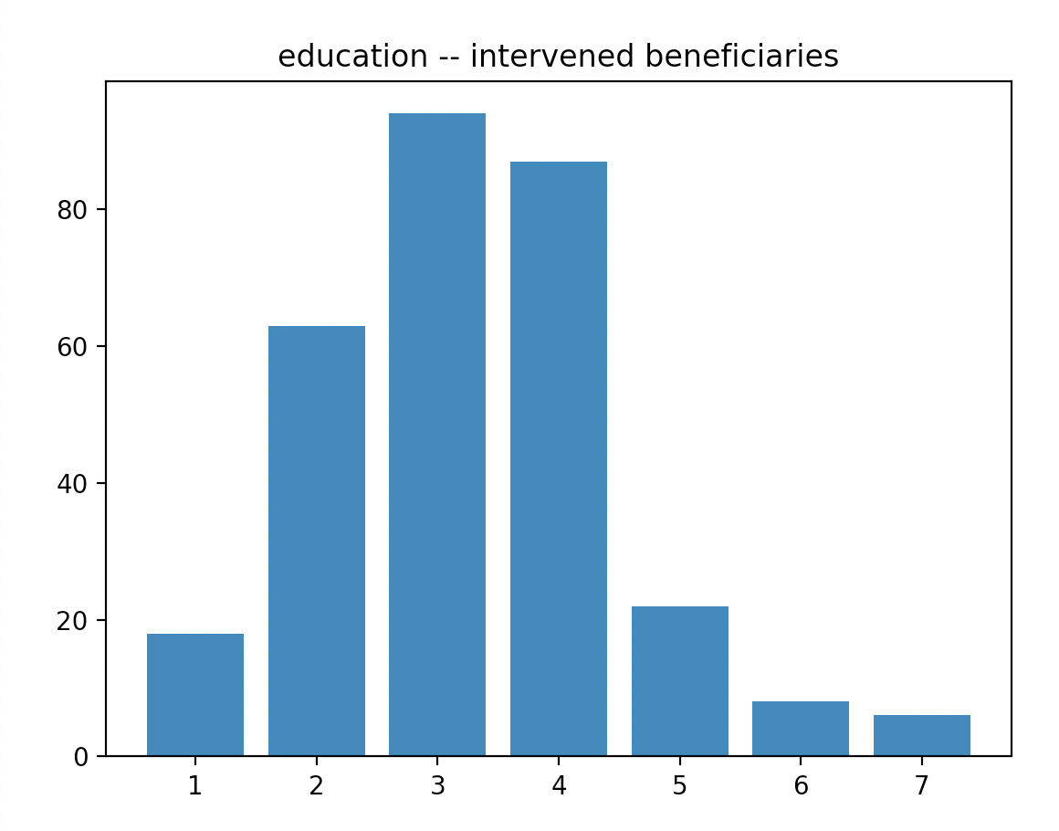
ARMMAN: DEPLOYED SYSTEM
Service calls now scheduled by AI system
Trustworthy: Fairness, Continuous Testing, Partnership with NGO

Slide 9
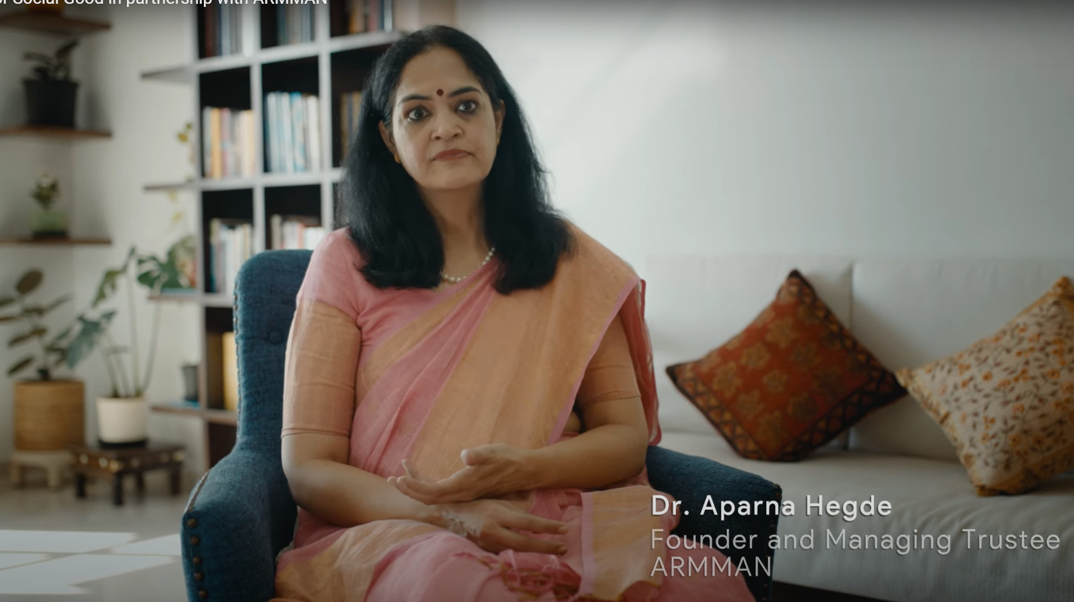
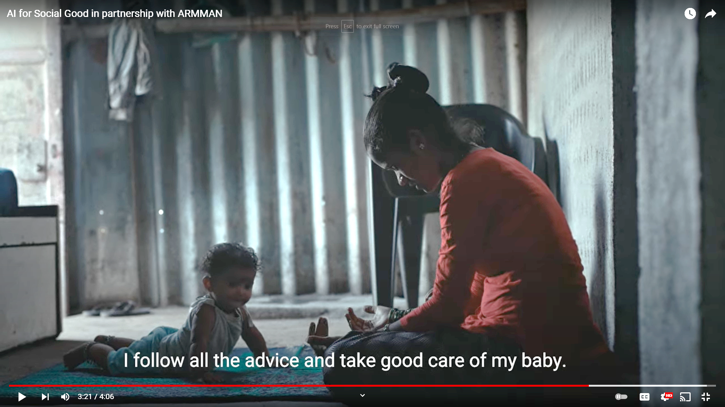
ARMMAN Deployed System Youtube: “AI for Social Good in partnership with ARMMAN”
“We are able to reach out to more and more women each week, and get them back into the fold and save lives, because of AI” – Dr Aparna Hegde
“I follow all the advice and take good care of my baby”

