Slide 1
Introducing Cat Royale
Prof. Steve Benford, University of Nottingham
Ju Row Farr and Nick Tandavanitj, Blast Theory
TAS Cultural Ambassadors: Blast Theory

Slide 2
TAS Creative Programme
Notes:
Reminder about the TAS Creative Programme
a. Why we engage the arts
i. Creative provocations by artists – takes TAS to unusual places
ii. Touring as a public lab
iii. Culture and creative industries are important and deserve consideration by TAS - using appropriate methods
b. Artists residency – Richard, Roma, Ali, Rachel
c. Venue partners including National Gallery and Royal Academy of Arts
Introduce Blast Theory as TAS Artist Ambassadors
Explain that we have spent the past 6-9 months researching and designing a flagship project
Comment on artist-led research method

Slide 3
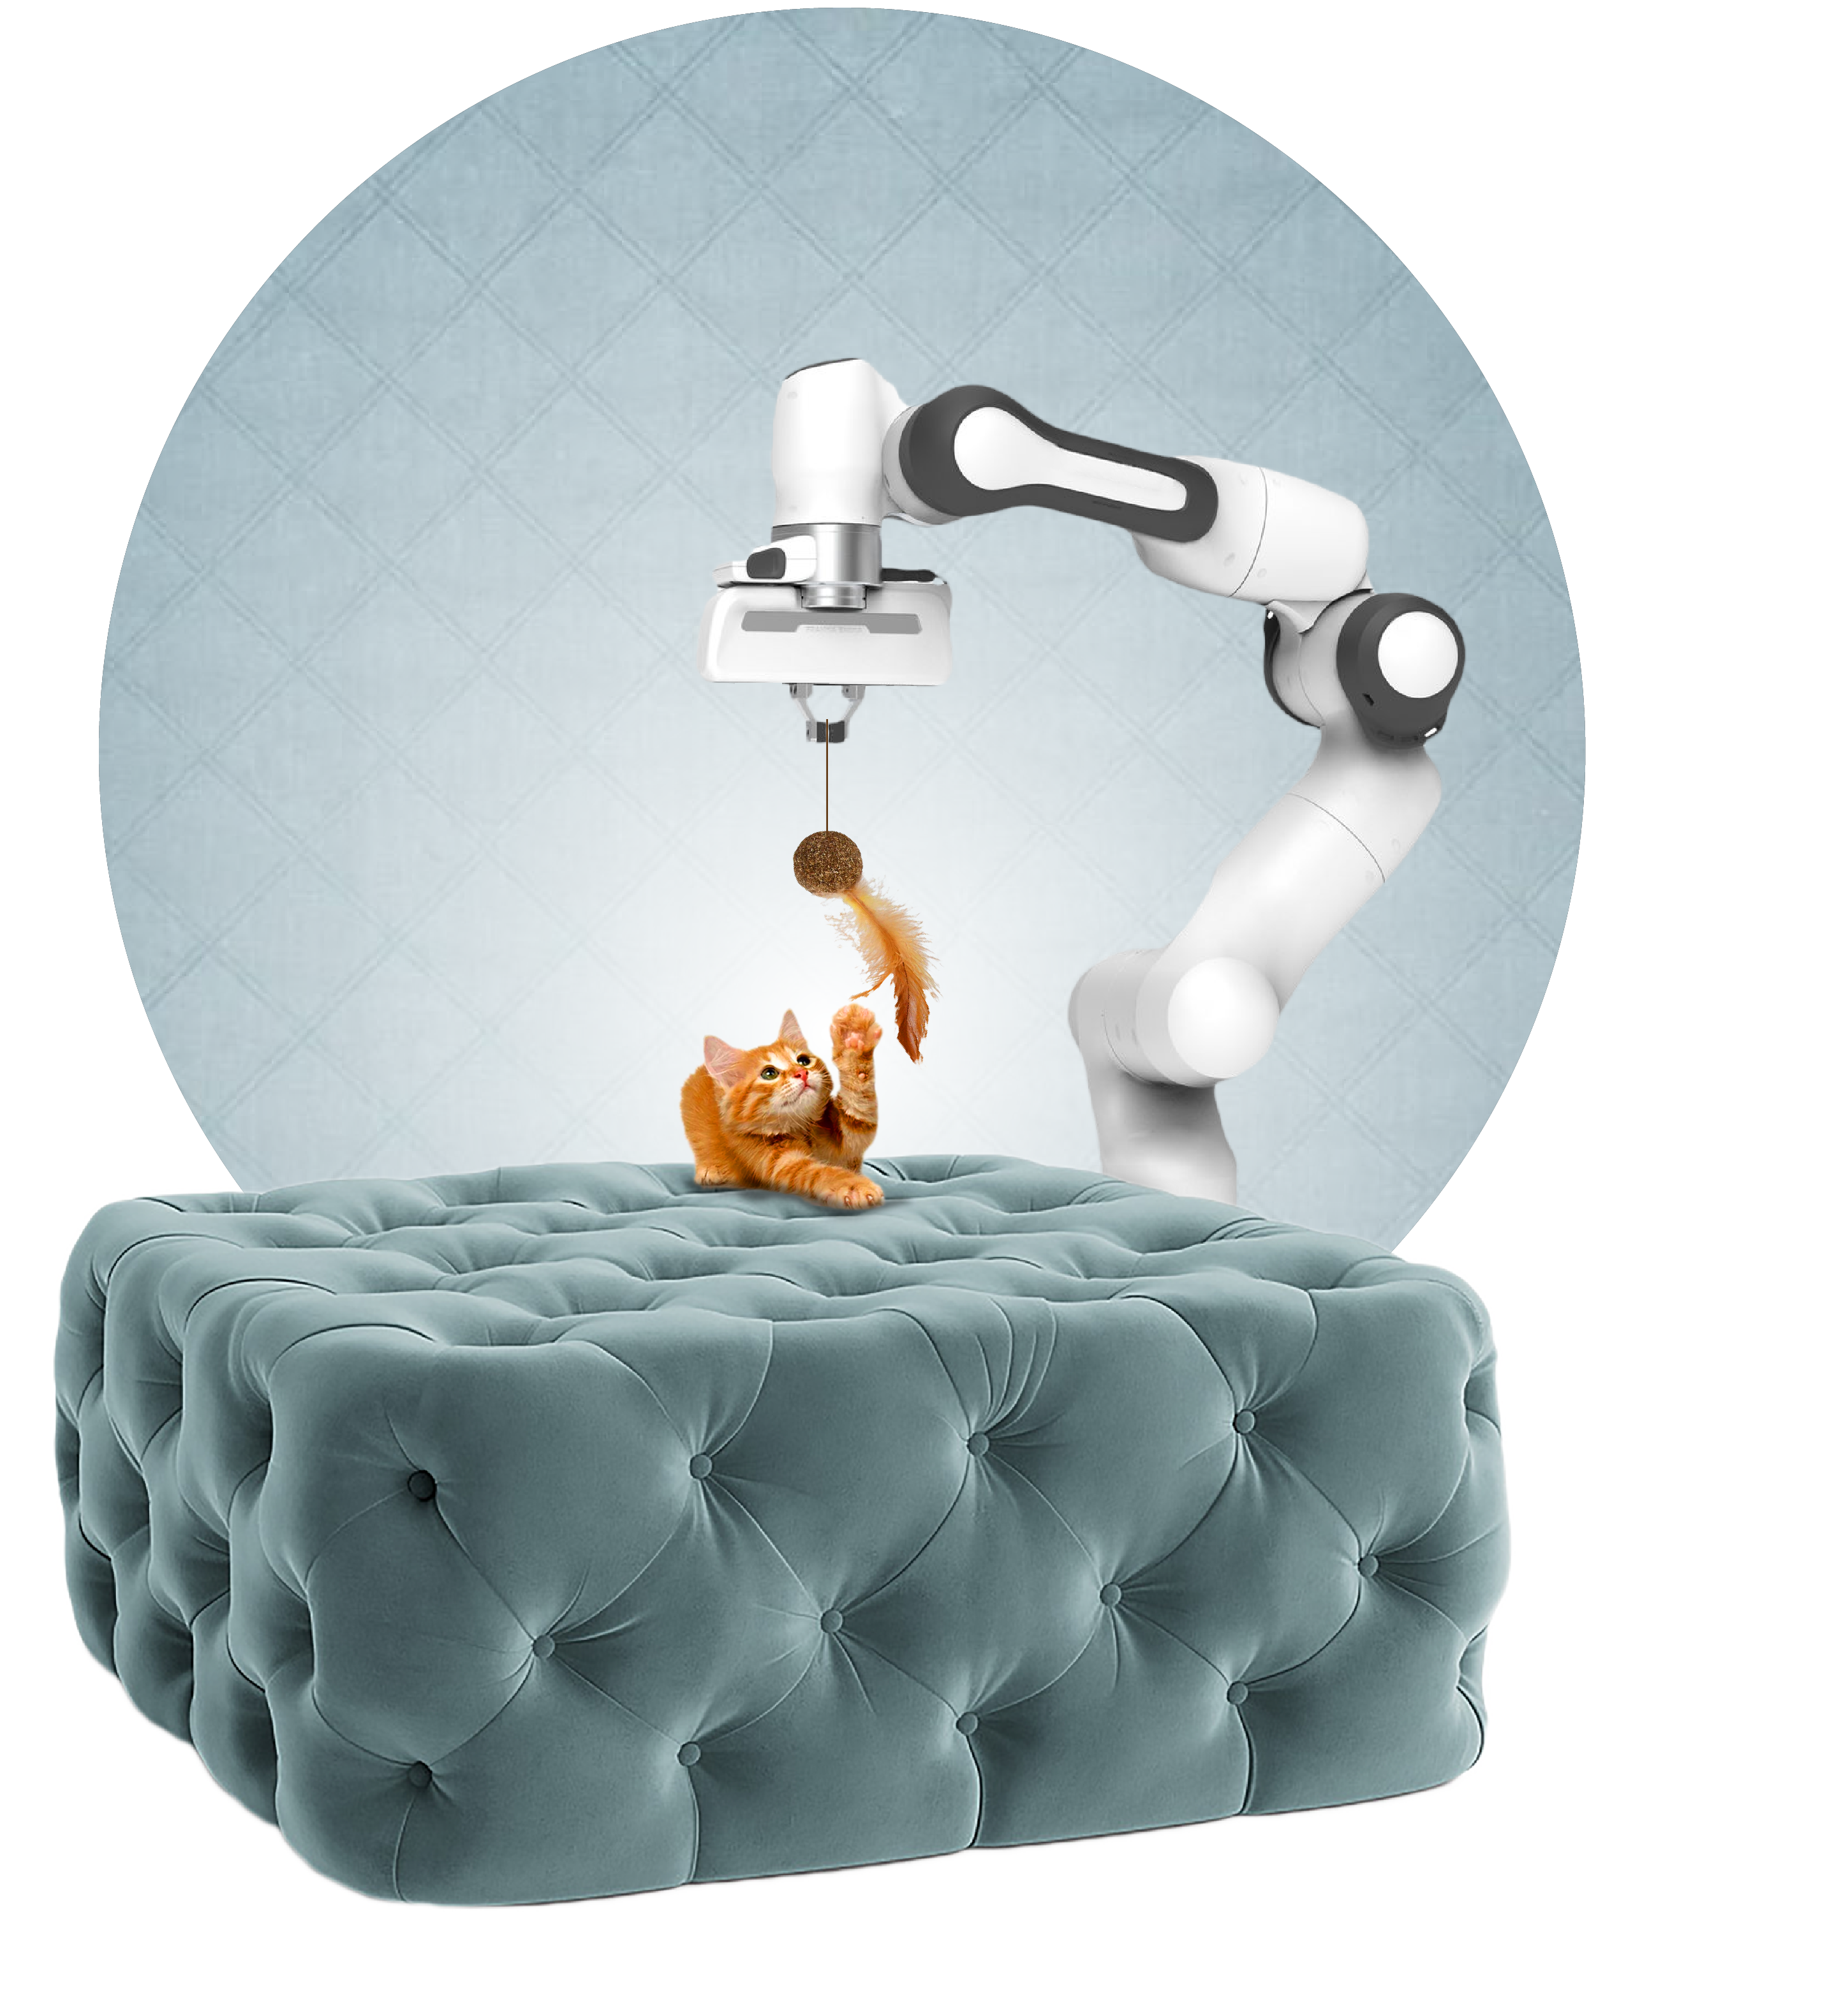
About Cat Royale

Slide 5
How Cat Royale speaks to TAS
Public understanding of trust in autonomous systems
Designing future autonomous systems for animals
The need for creative design methods and tools for autonomous systems

Slide 6
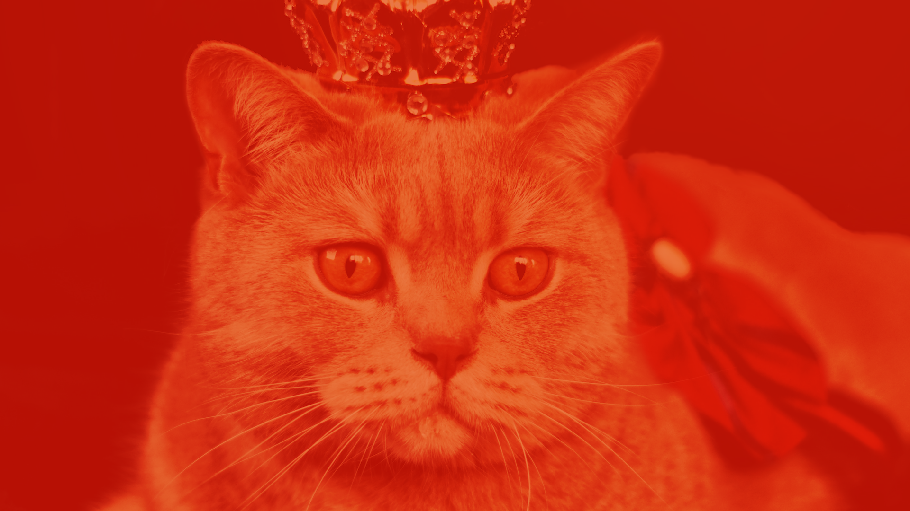
Thank you
steve.benford@nottingham.ac.uk
ju@blasttheory.co.uk
nick@blasttheory.co.uk
@blasttheory
blasttheory.co.uk

